Slide 1
Effects on Mental Health of Health Care Workers Due to CovID19
GROUP MEMBERS
MUBASHIR ALI MSDS20085
QAZI DANISH AYUB MSDS20075
ABDULLAH AZIZ MSDS20052

Slide 2
Motivation
Medical workers are the frontline for this fight against a pandemic
During these hard times a lot of other different factors make things more stressful
Non availability of beds, shortage of ICU/Medications
People are out of jobs, businesses are closed, self-isolated with fear of unknown.
Improper lockdown policies
Non-serious attitude of general public about social distancing, sanitization measures
Rising number of cases

Slide 3
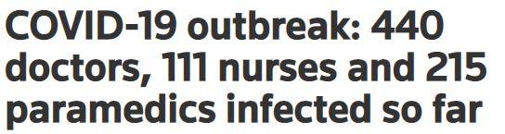

Observations
In other parts of the world an increase in following mental conditions were observed
Anxiety
Stress
Insomnia
Depression

Slide 4
Process
Designing the Questionnaire (based on DASS21)
Data Collection(online survey & manually)
Compiling data from different sources & visualization
Deciding Distribution of data (by visualization; histograms, box plots, mean median)
Preprocessing
Analyzing Data (removing unwanted columns)
Statistical analysis/ population parameters estimation, confidence interval

Slide 5

Data Collection
Designing Questionnaire(keeping questions as simple as possible)
Personal Information
Dass 21
Manually Visiting Hospital
Online form design
Online Survey
Translation of questionnaire

Slide 6
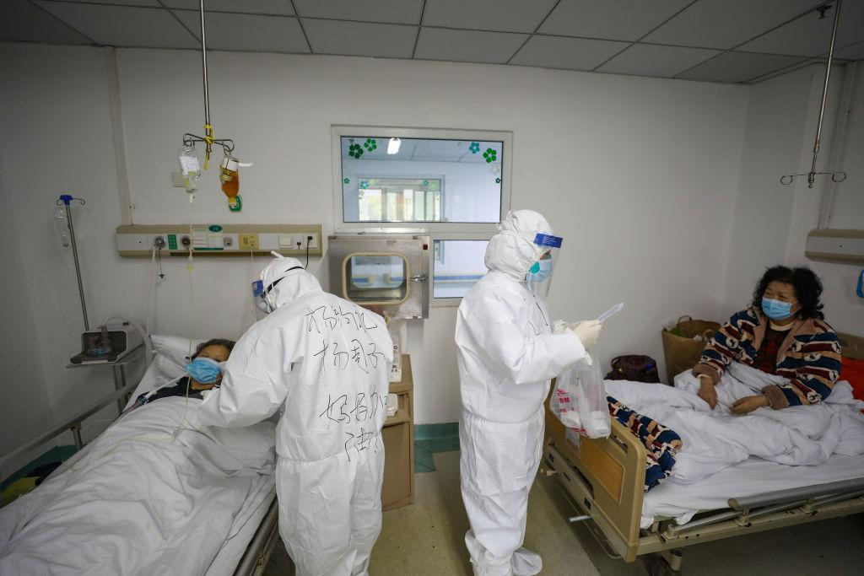
Issues in Data Collection
Reaching out to doctors for participation
Making sure enough responses are collected
literacy comprehension barrier
Getting affected with corona
Doctors were not willing to meet

Slide 7
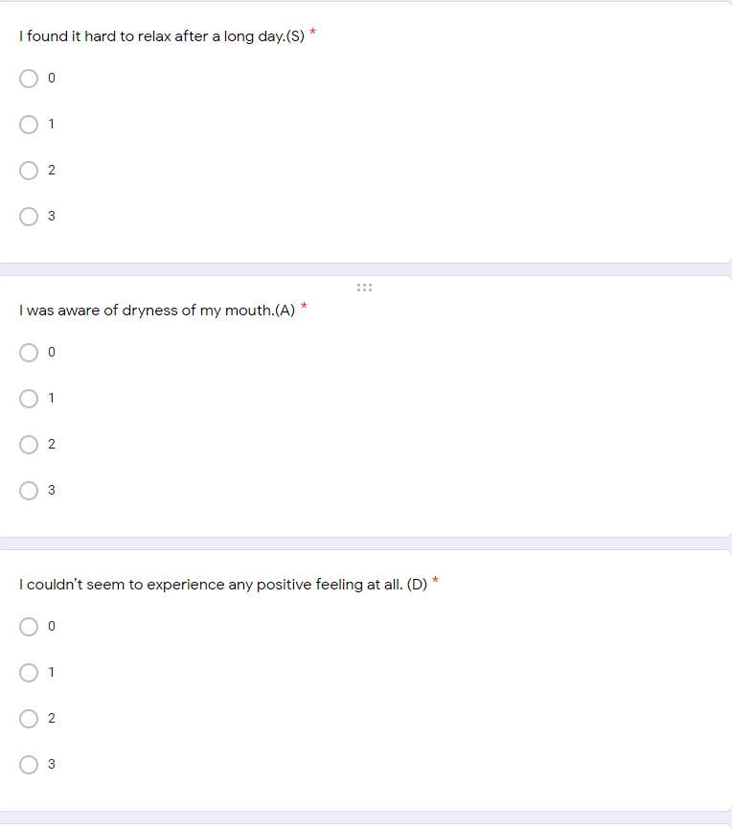
Questionnaire Sample
A sample for questionnaire
English version
Urdu version

Slide 8
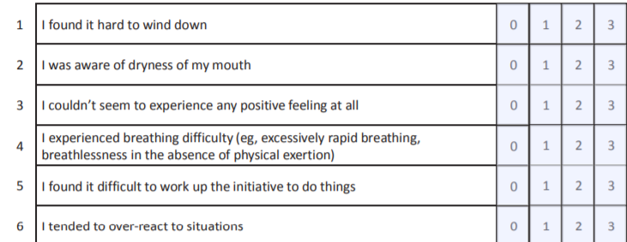
Questionnaire for mental disorder diagnosis(DASS21)
It is a set of three self-report scales designed to measure the negative emotional states of:
depression
anxiety
stress

Slide 9
Data Preprocessing
Compiling data obtained from different sources
Data visualization
Analyzing Data
Conversion of question into variable
Standardizing names of cities
Dropping unwanted columns
Cities | Label
multan, mulltan, Layyah, Kahror Pacca | Multan
lahore, Lahorw, Lhr, Lahore | Lahore
Rawalpindi, Rawalpindi, Rawal pindi ,rawalpindu, Rwp, Rawalpi di, Pindi, Chakwal, rawat | Rawalpindi
Islambad, Islamabad, Isb, islamabad | Islamabad
Mirpur azad Kashmir, Bhimber AJK | AJK
Sialkot, Gujrat | Sialkot
Khushab, Sargodha | Sargodha
Karachi | Karachi

Slide 10
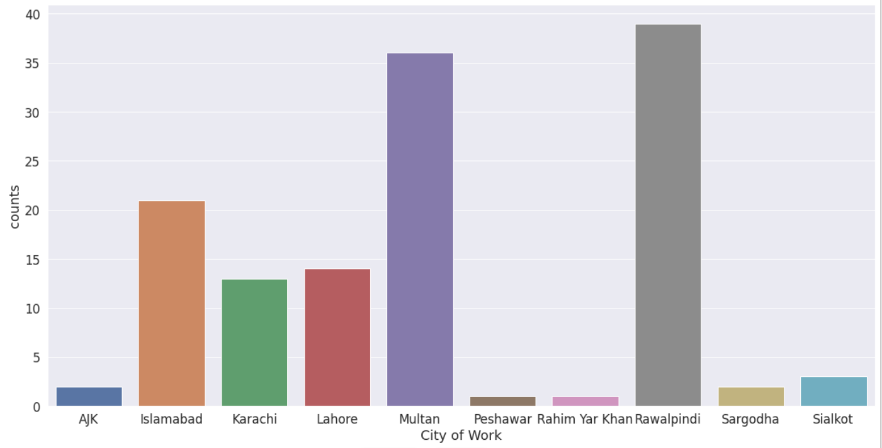
Data Visualization

Slide 11
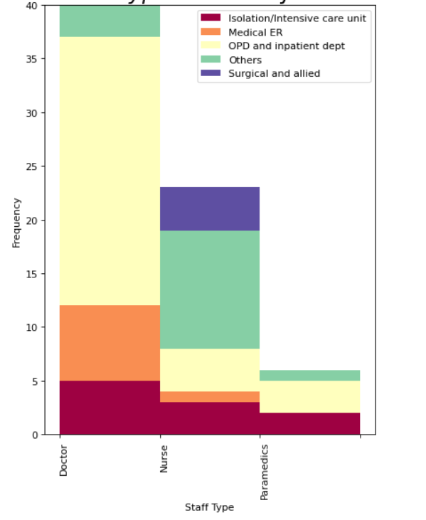
Data Visualization

Slide 12
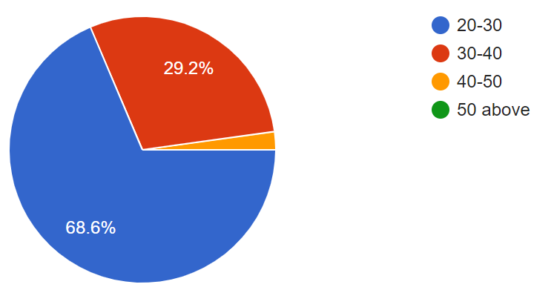
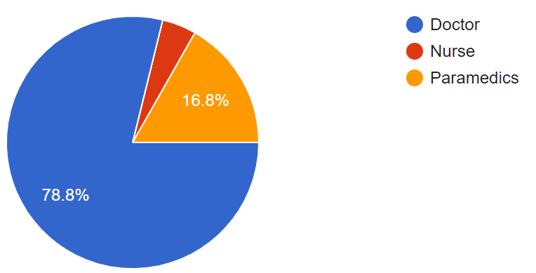
Data Visualization
68.6% of people have age between 20-30
29.2% of people have age between 30-40
78.8% of people were doctors
16.8% of people are Paramedics
Age
Staff Type

Slide 13
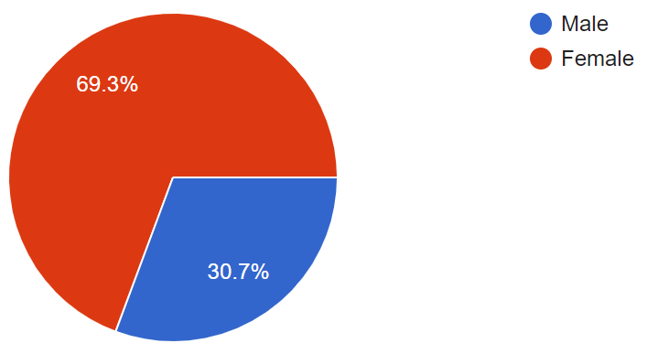
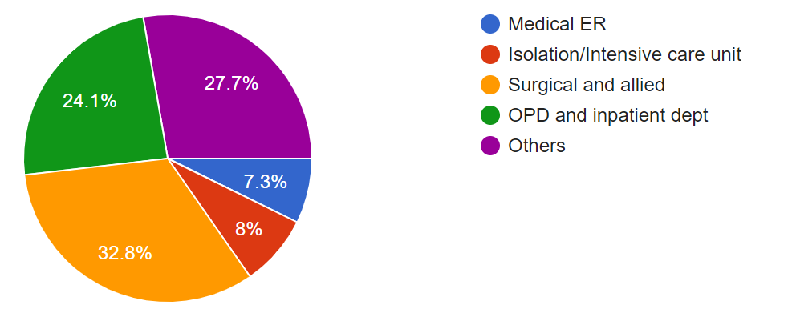
Data Visualization
69.3% of people are Female
30.7% of people are Male
32.8% people works in Surgical and allied
24.1% people works in OPD
7.3% of people works in Medical ER
Gender
Current Working Department

Slide 14
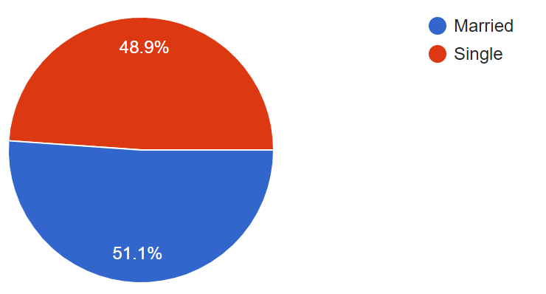
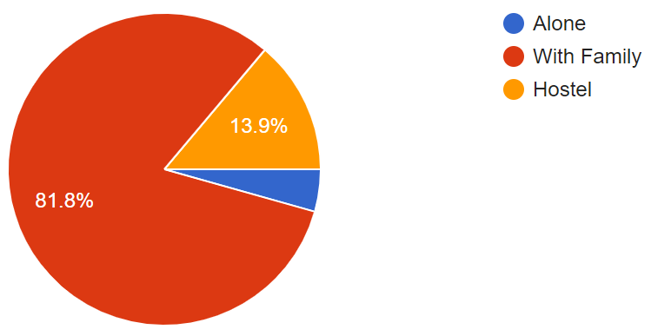
Data Visualization
48.9% of people are single
51.1% of people married
81.8% of people lives with family
13.9% of people lives in hostel
Marital Status
Living Situation

Slide 15
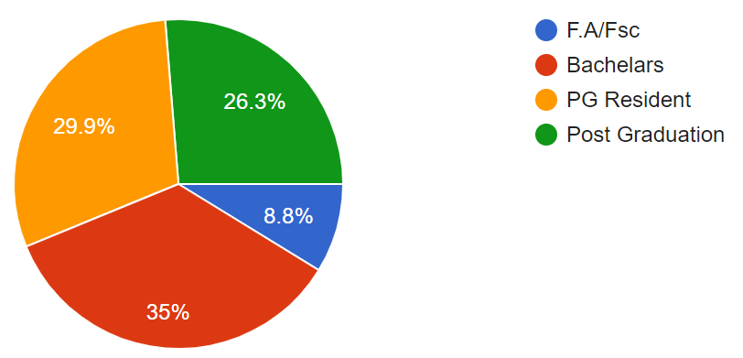
Data Visualization
35% of people are Bachelors
29.9% of people are PG Resident
26.3% of people are Post Graduated
8.8% of people are F.A/Fsc
Education

Slide 16
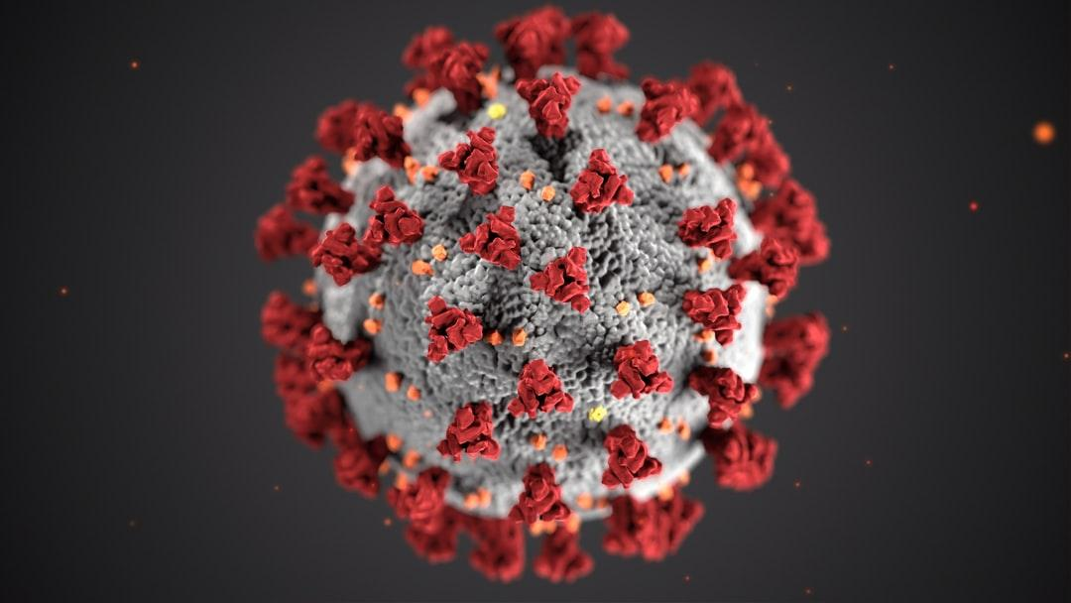
Methodology
Dass21
Population parameters estimation
Confidence Interval

Slide 17
Dass 21
The rating scale is as follows:
0 Did not apply to me at all.
1 Applied to me to some degree, or some of the time.
2 Applied to me to a considerable degree or a good part of time.
3 Applied to me very much or most of the time.
Scores for depression, anxiety and stress are calculated by summing the scores for the relevant items shown in Table

Slide 18
Dass 21 Tabbe
Level | Depression | Anxiety | Stress
Normal | 0-9 | 0-7 | 0-14
Mild | 10-13 | 8-9 | 15-18
Moderate | 14-20 | 10-14 | 19-25
Severe | 21-27 | 15-19 | 26-33
Extreme Severe | 28 | 20 | 34

Slide 19
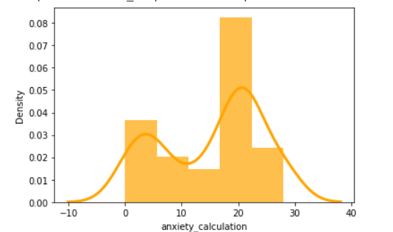
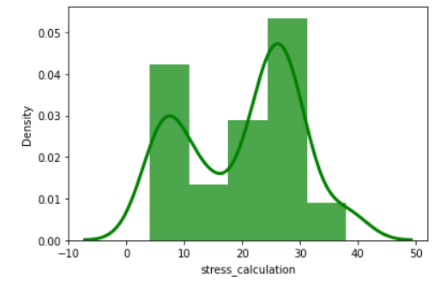
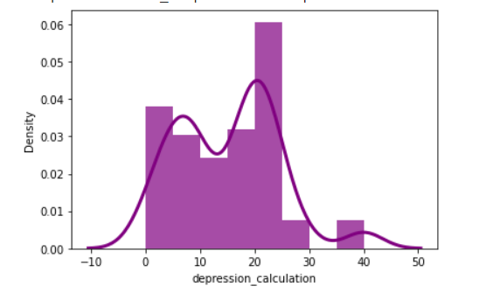
Results Dass 21
Anxiety Distribution
Stress Distribution
Depression Distribution

Slide 20
Mean Median & STD
Mental Disorder | Mean | Median | STD
Depression | 14.43 | 14.0 | 9.38
Anxiety | 12.63 | 12.0 | 9.06
Stress | 17.06 | 16.0 | 9.70

Slide 21
Result of Confidence Interval
Mental Disorder | Alpha | significance level | Lower Level | Upper Level
Depression | 0.05 | 5% | 12.8228 | 16.0559
Anxiety | 0.05 | 5% | 11.0751 | 14.1976
Stress | 0.05 | 5% | 15.3889 | 18.7322

